Slide 1

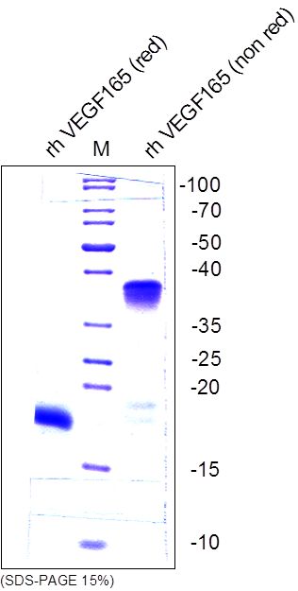
ReliaTech GmbH
Recombinant human VEGF165
(Cat #300-075 / -076)
Fig. 1: SDS-PAGE analysis of recombinant human VEGF₁₆₅ produced in E. coli. Sample were loaded in 15% SDS-polyacrylamide gel under reducing and non-reducing conditions and stained with Coomassie blue.
http://www.reliatech.de / orders@reliatech.de

